Slide 1
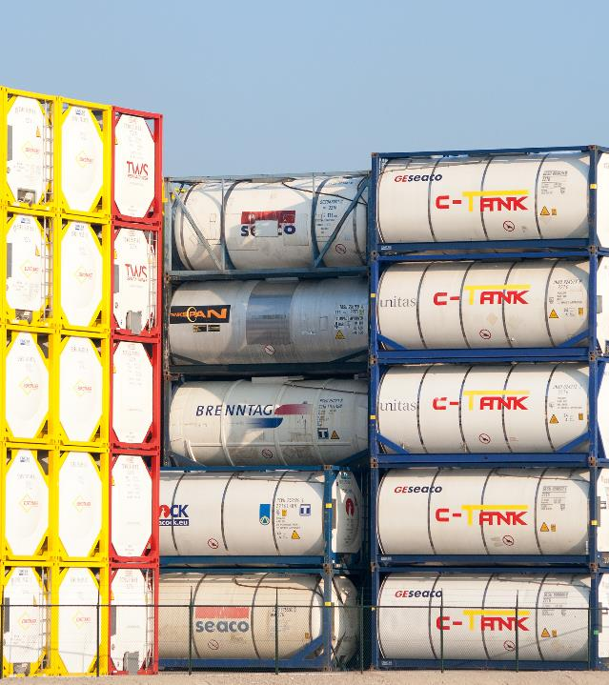
TANK-CONTAINERS FORWARDING BY RAILWAY
Riga, Latvia

Slide 2
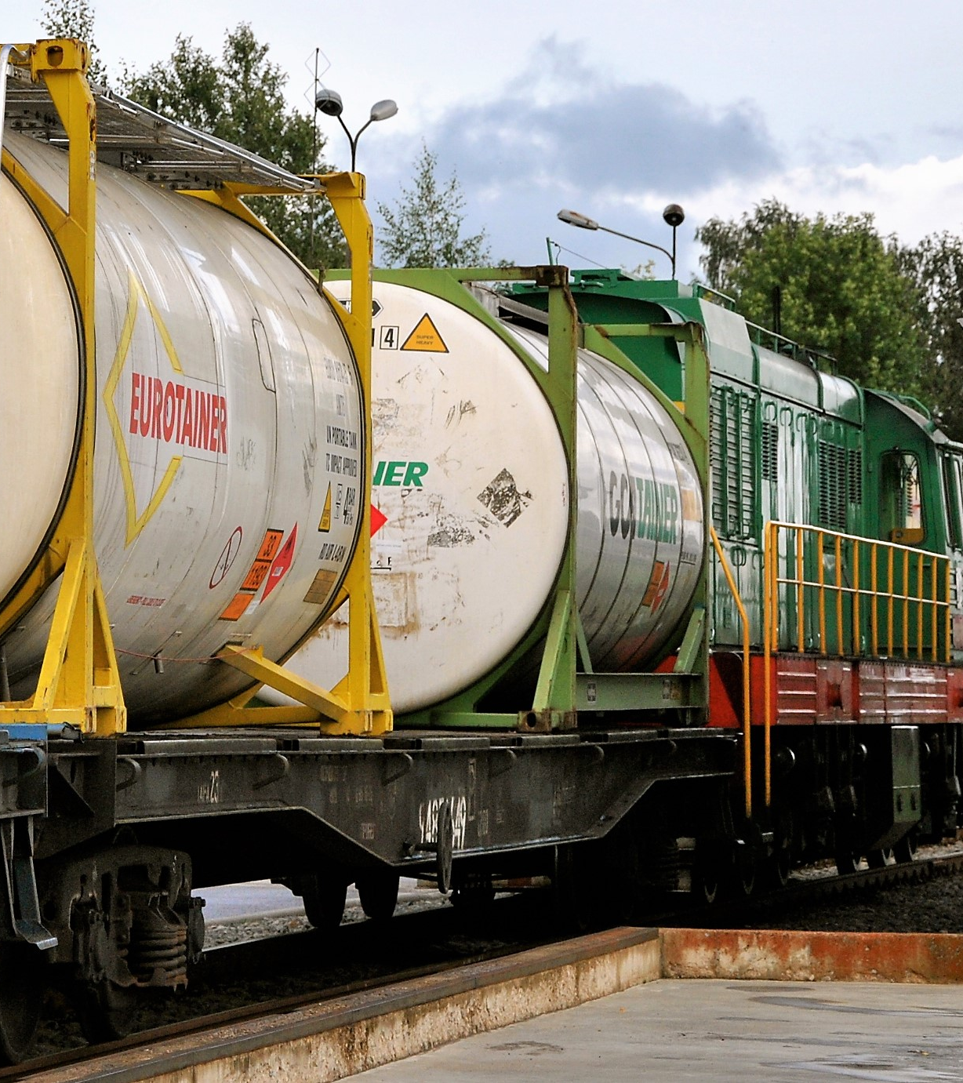
SERVICES
«Railway Logistics Service» provides full service of transportation by railway of various liquids in tank-containers to Russia, Central Asia countries, Azerbaijan, Belarus and Ukraine.
Our services includes:
Forwarding in Riga
Railway & customs formalities
Railcar supply
Rail tariff payment till a destination and return
Sea freight
Cleaning (if needed)
We offer both import and export transportation:
Roundtrips with empty return of containers to an owner
One-way shipments to a destination
Supply of empty containers to a loading place with loaded containers delivery to Riga
Chemicals (hazardous or non-hazardous)
Foodstuff liquids (beverages, alcohol, etc)
Oil products

Slide 3
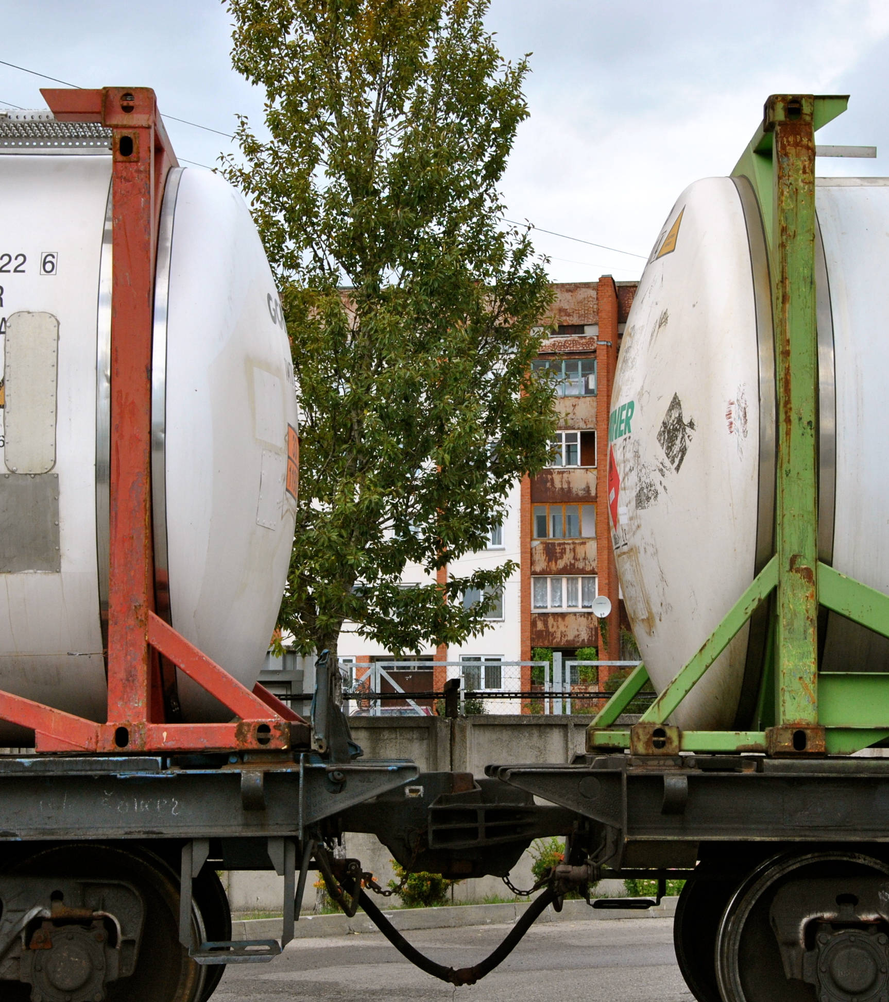
TYPES OF CONTAINERS
It is possible to transport following types of tank-containers by railway :
Type
20’ Tank
23’ Swap-body
30’
A shipment can performed for pared containers or as a single container shipment.

Slide 4
BENEFITS
Low tariffs
Delivery by railway is cheaper than by trucks
Empty return of containers
Possibility to return empty equipment to the owner’s depot
No dangerous goods surcharge
There is no DG surcharge for railway dispatches
No weight limits
Containers can be loaded upto max load capacity
No quantity limits
It is possible to ship big quantity of containers in one shipment
Access to heavy-payload railcars
Tank-containers need to transported on special railcars
Easy border crossing
EU border crossing takes not more than 6 hours
Safety
Rail transport is much more safer than road

Slide 5
TARIFFS
Railway
Route | Transit time, oneway | Round trip , 20 TC EUR
Vladimir (Yuryevets) RU | 7 | 1350
Kazan’ RU | 8 | 1590
Nizhnekamsk (Biklan’), RU | 7 | 1770
Karagandy, KZ | 12 | 2890
Almaty, KZ | 14 | 3250
Tashkent, UZ | 12 | 4290
Baku, AZ | 12 | 2950
Sea freight
Route | 20’loaded , EUR | 20’empty , EUR
Rotterdam - Riga
The tariffs are indicative . Please contact us to discuss the terms and destinations you need.
Tariffs include full freight forwarding services Free-On-Rail Riga – Free-On-Rail destination with empty container return.

Slide 6
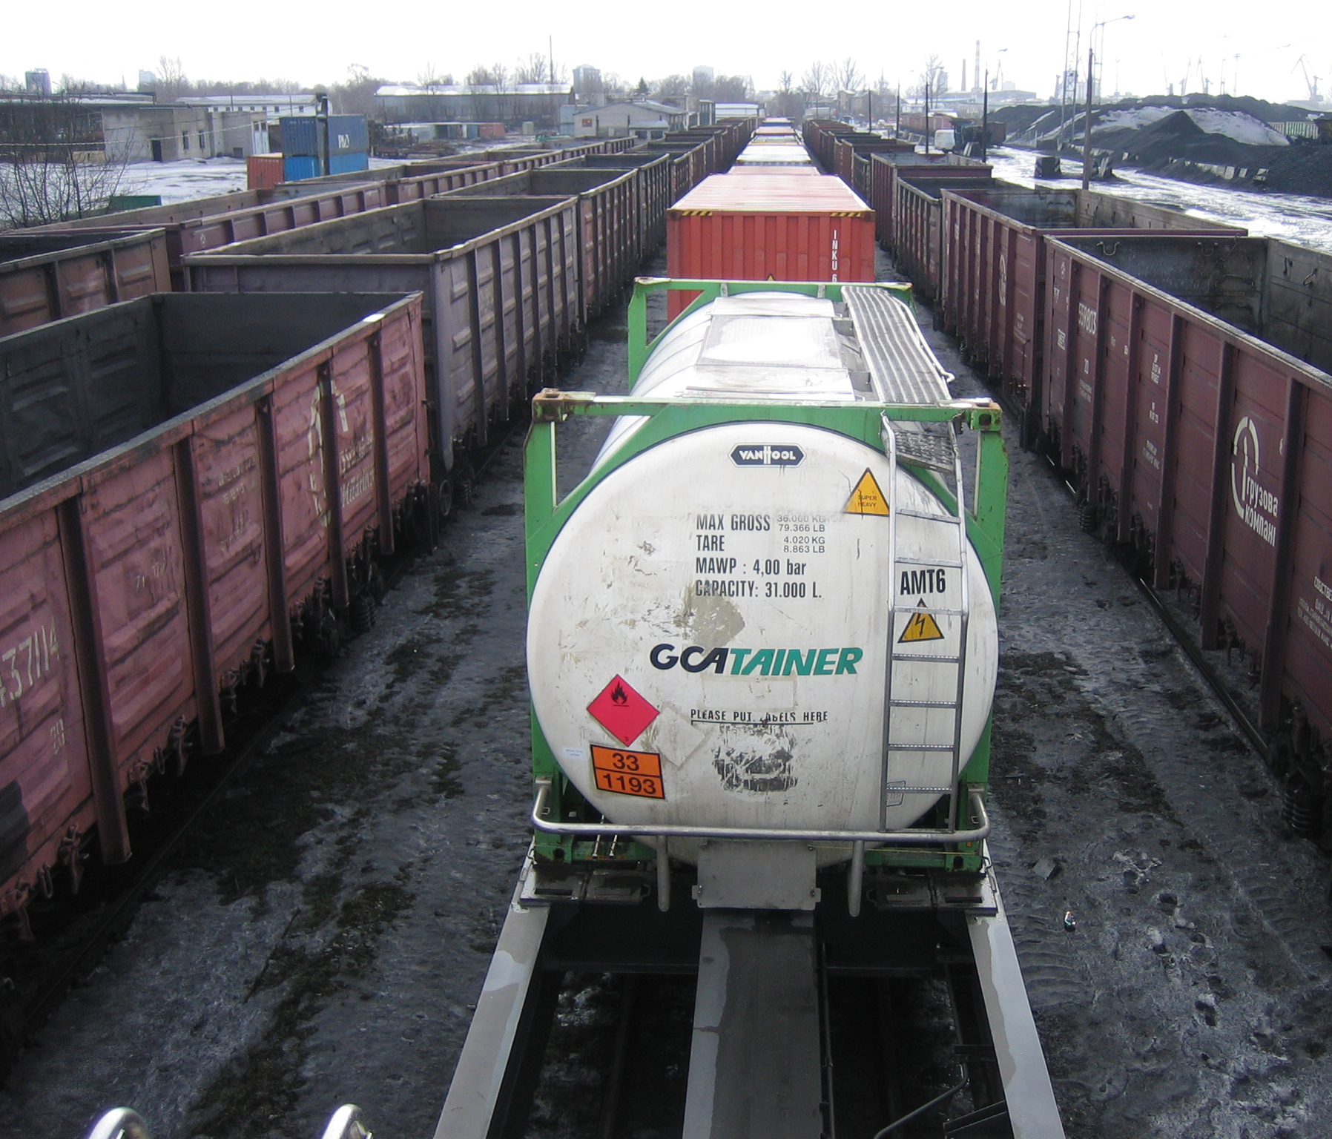
CONTACTS
Railway Logistics Service Ltd.
www.railway.lv
Ph: +371 20111777
Email: rls@railway.lv

